Slide 1


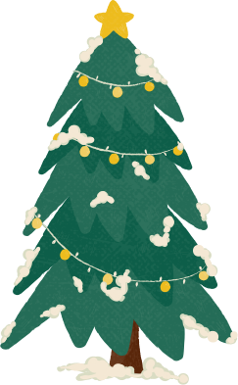





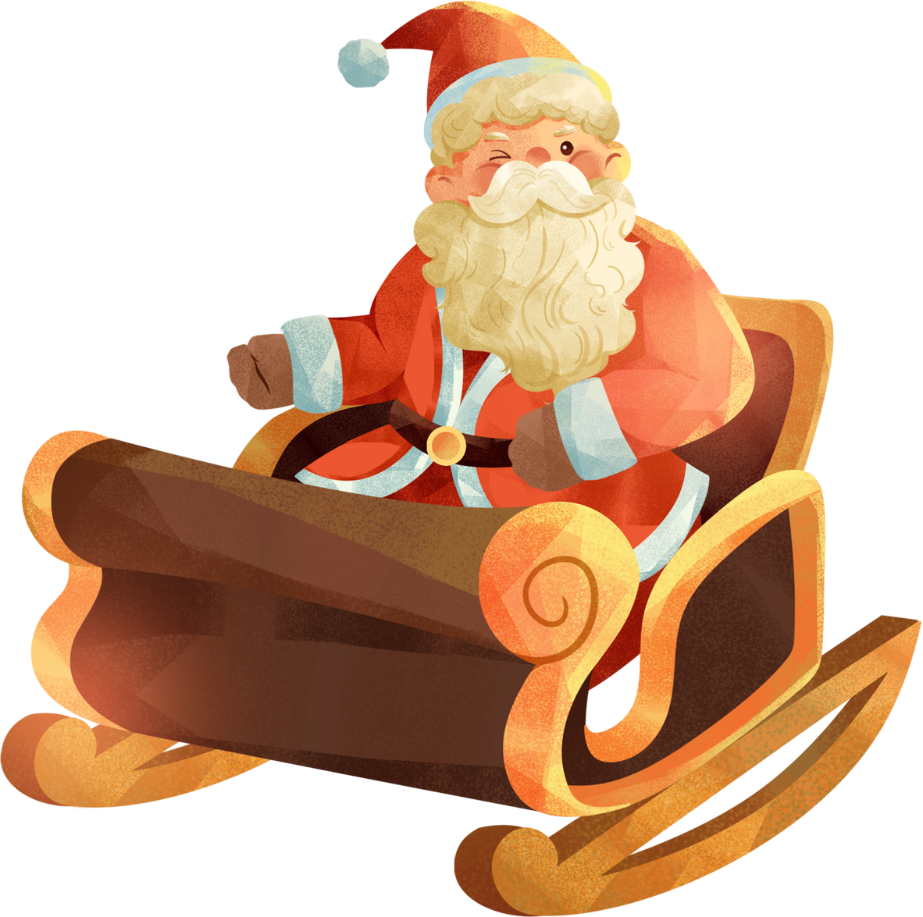

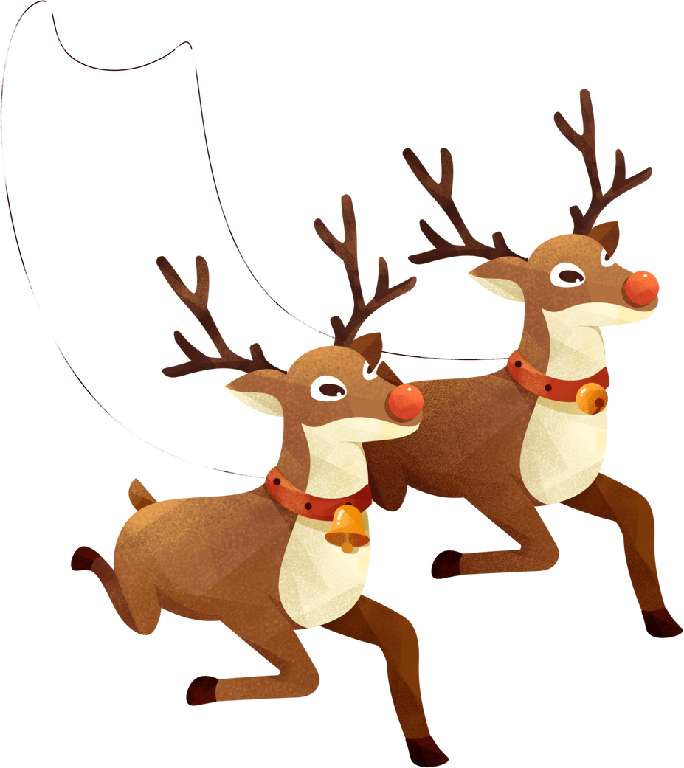

Merry
Christmas
Spreading Cheer and Creating Memories

Slide 2
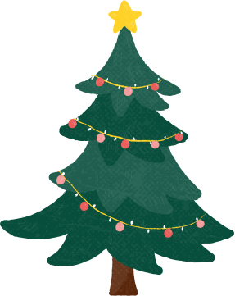



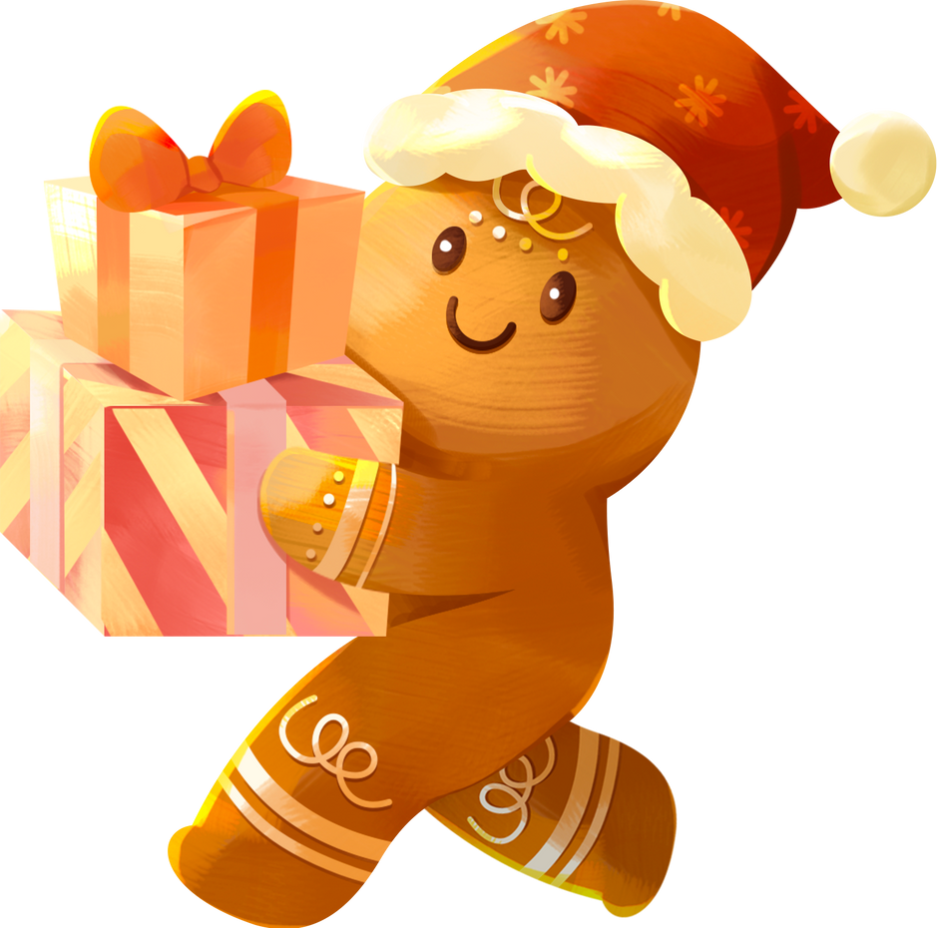


Christmas is a magical time of year, filled with joy, togetherness, and the spirit of giving.
Let’s dive into the traditions, meaning, and beauty of this cherished holiday

Slide 3
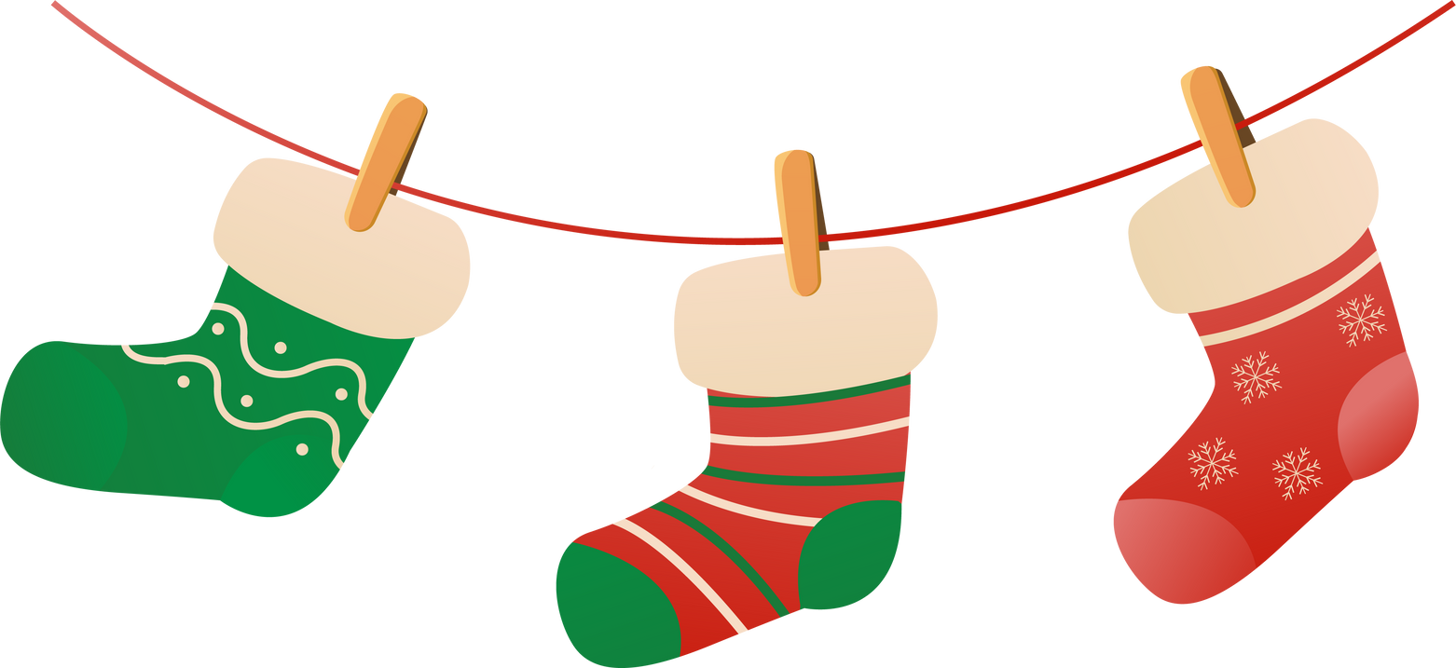
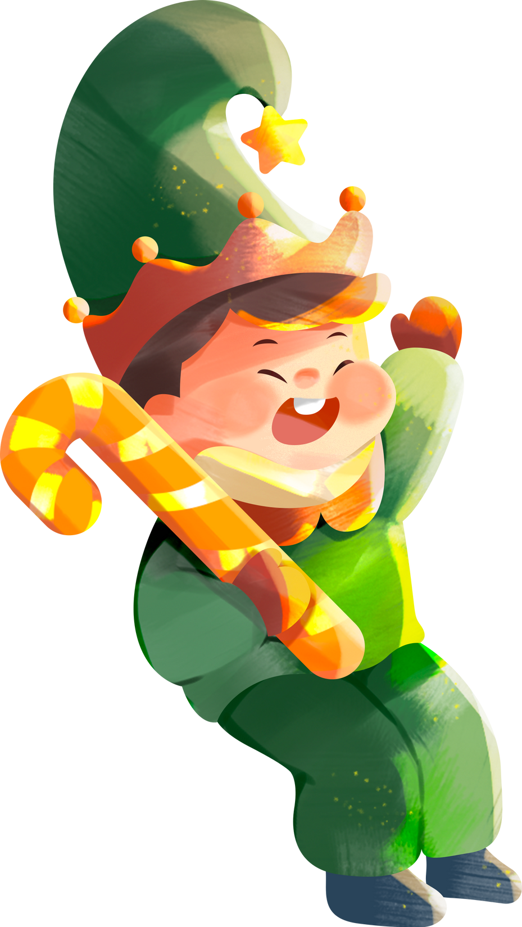
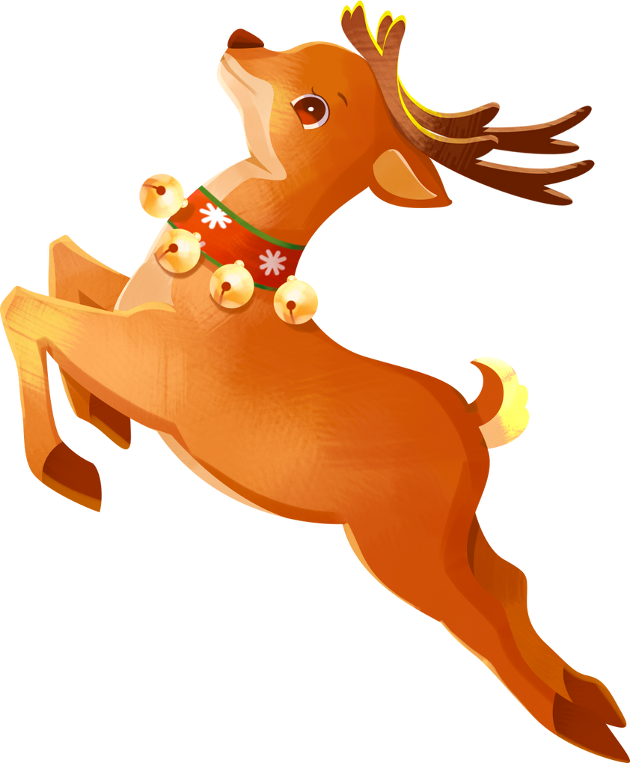

The Heart of Christmas
Christmas celebrates the birth of Jesus Christ and represents hope, love, and unity. Beyond its religious significance, it’s a global celebration of family, kindness, and generosity.

Slide 4


The History of Christmas
Christmas has evolved over centuries, with origins in Christian and pagan traditions. From early nativity plays to modern festivities, it has become a celebration cherished by cultures worldwide.

Slide 5




Meaning Behind the Decorations
Each Christmas symbol carries a unique meaning:
Christmas Tree:
Star:
Wreath:
A symbol of eternal life.
Represents the Star of Bethlehem.
Signifies eternity and unity.

Slide 6
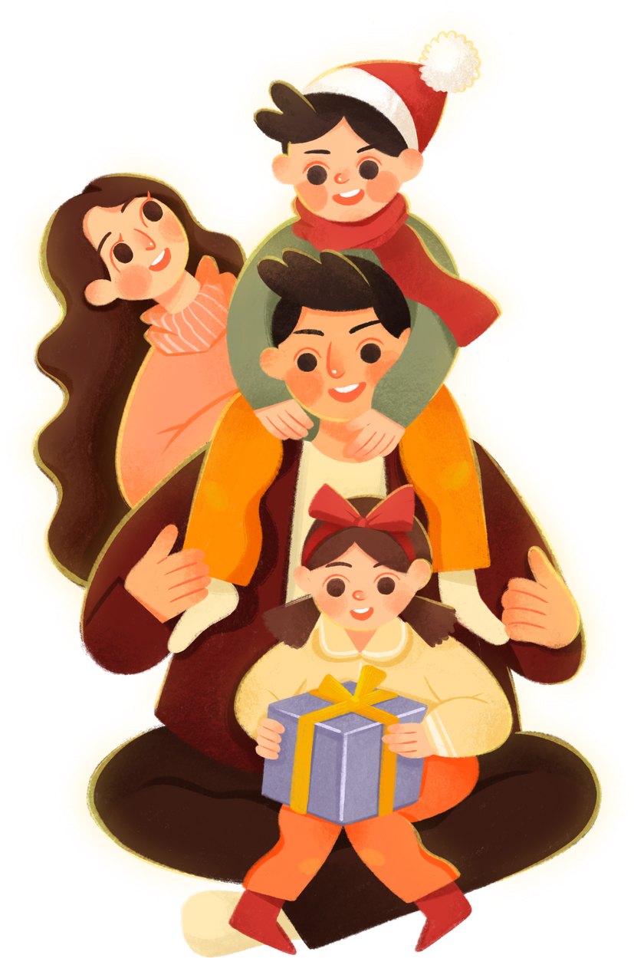
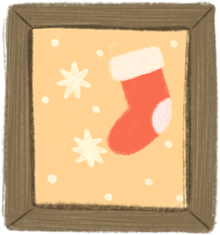


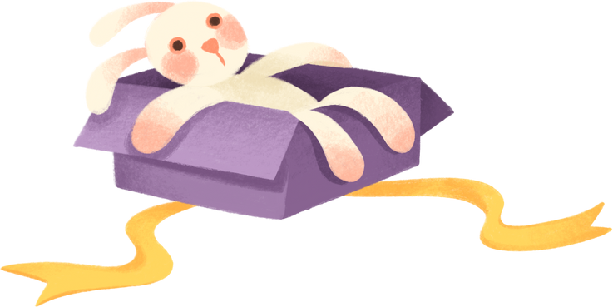

Family and Togetherness
Christmas brings families together to celebrate traditions and create memories. From decorating the tree to sharing meals, it’s a time to reconnect, reflect, and strengthen relationships.

Slide 7
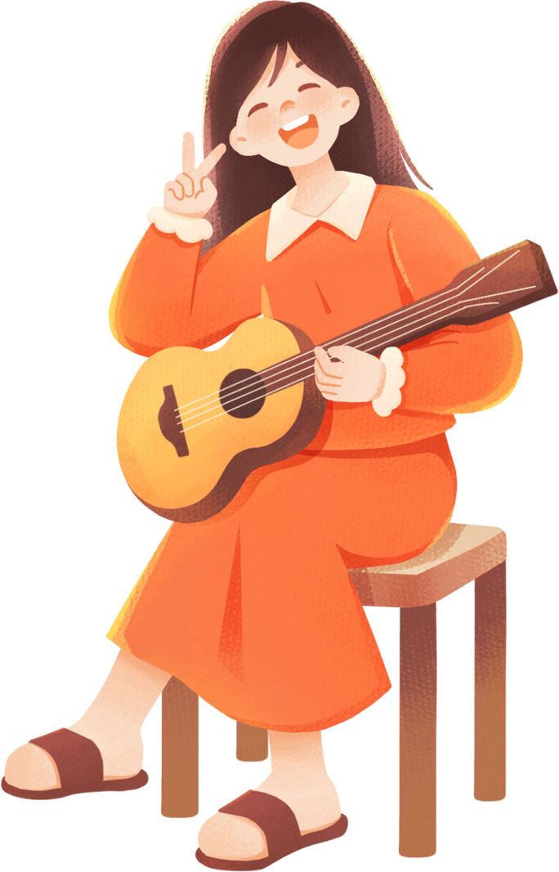

The Joy of Giving
The act of giving reflects the true spirit of Christmas. It’s not just about material gifts but also acts of kindness, time, and love that brighten the lives of others.

Slide 8

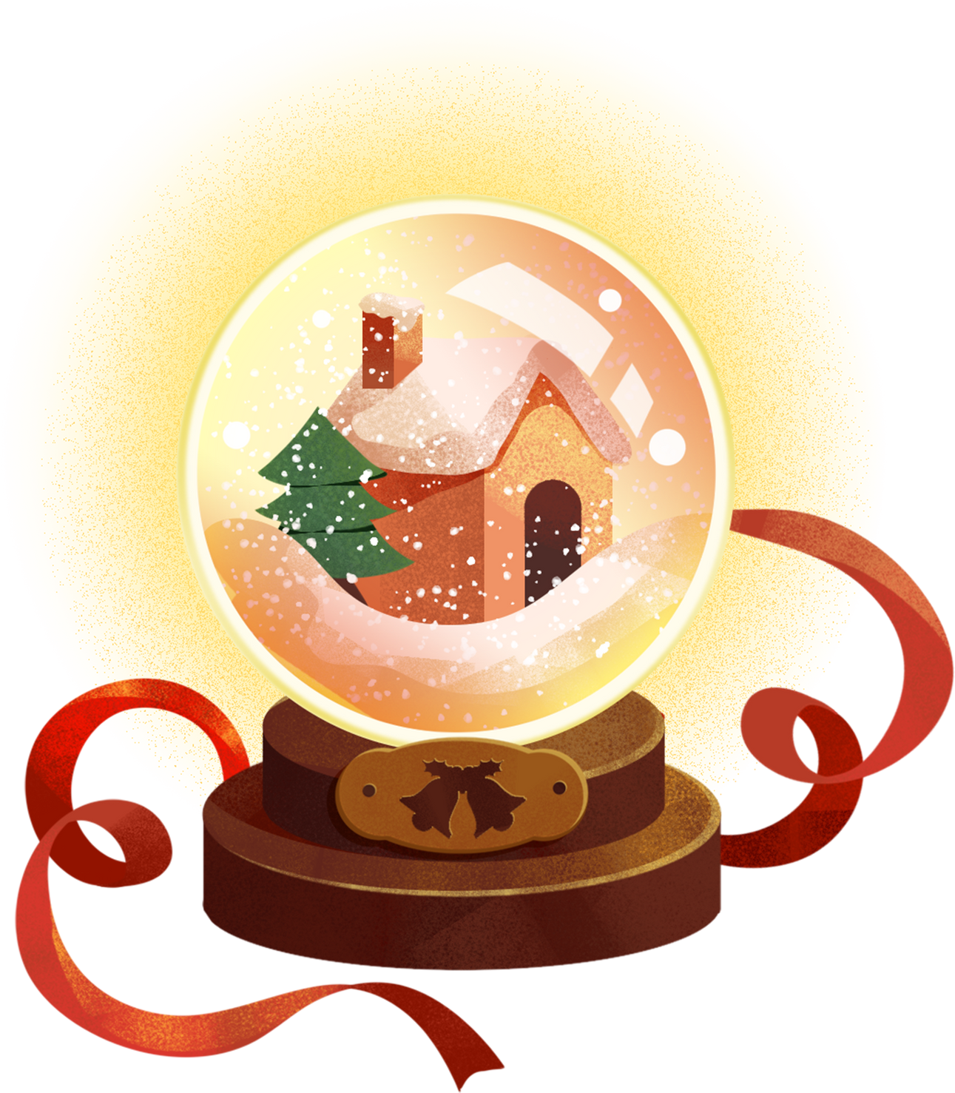
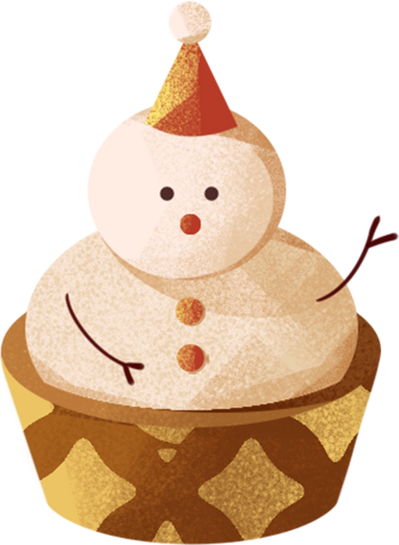
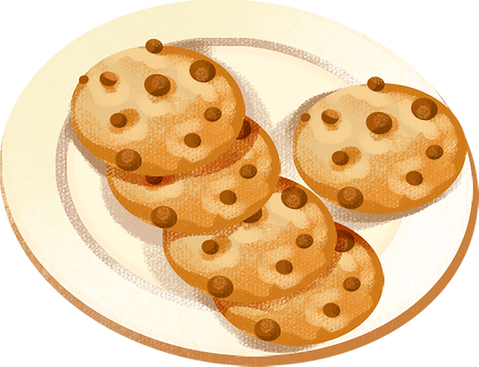

The Magic of Christmas Lights
Christmas lights and decorations bring a magical glow to streets, homes, and communities. They symbolize the light of hope and joy, illuminating the darkest days of winter.

Slide 9

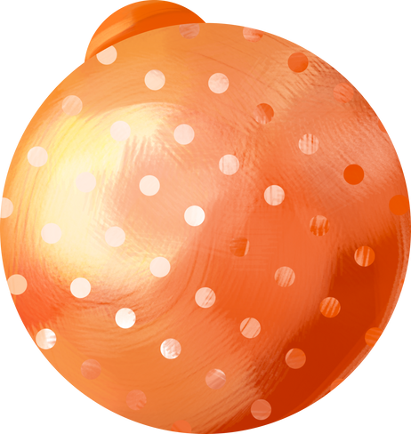
“As we celebrate this season, let’s cherish the joy, love, and hope that Christmas brings. May your holiday be filled with warmth, laughter, and unforgettable moments. Merry Christmas!”

Slide 10

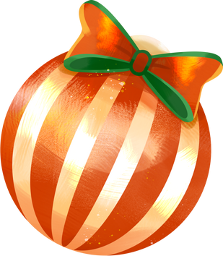
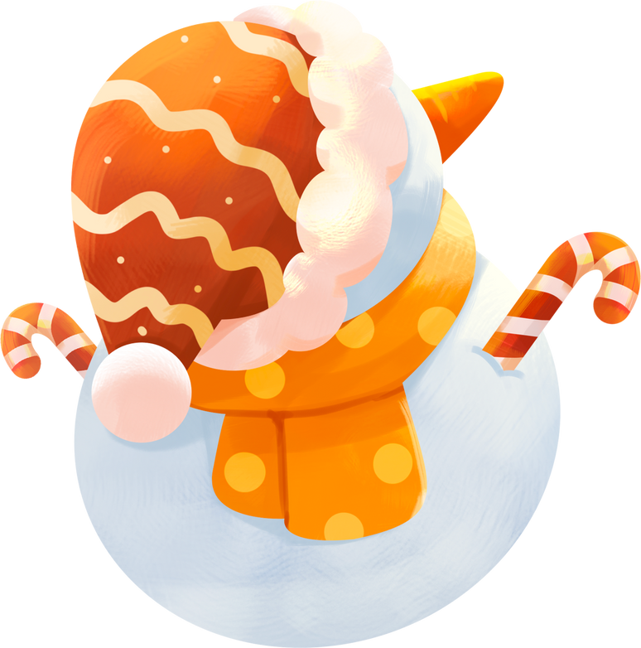

Wishing You a
Merry Christmas

