Slide 1


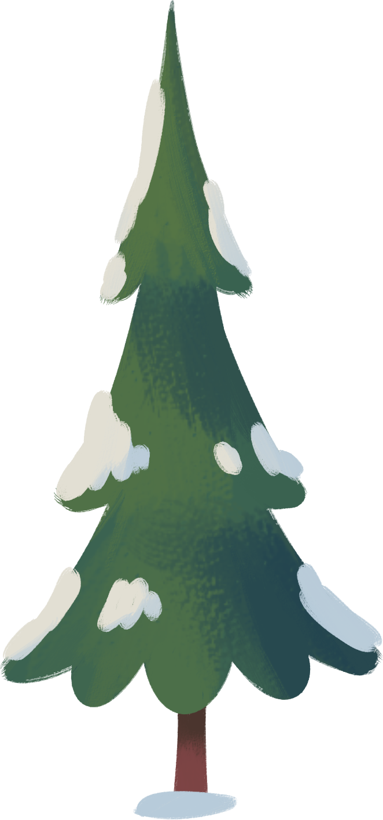








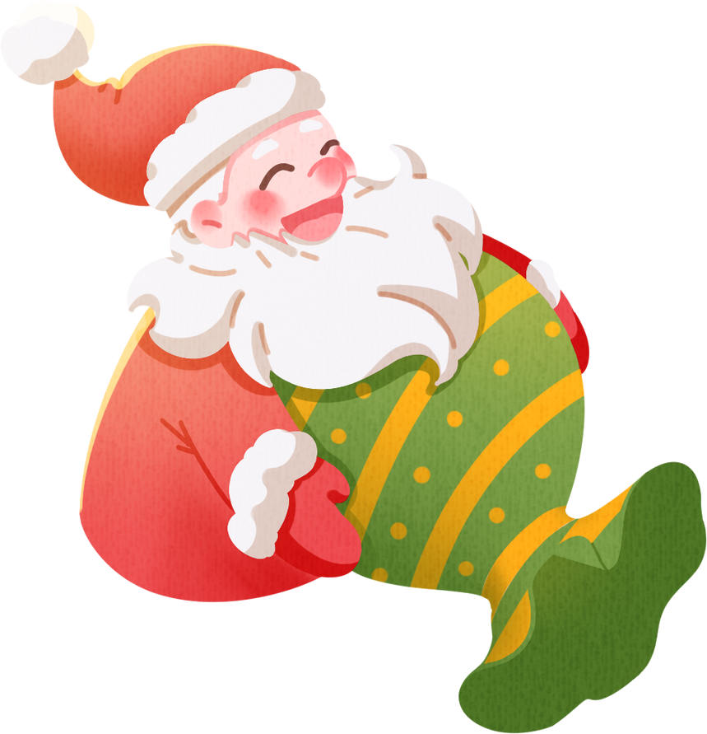
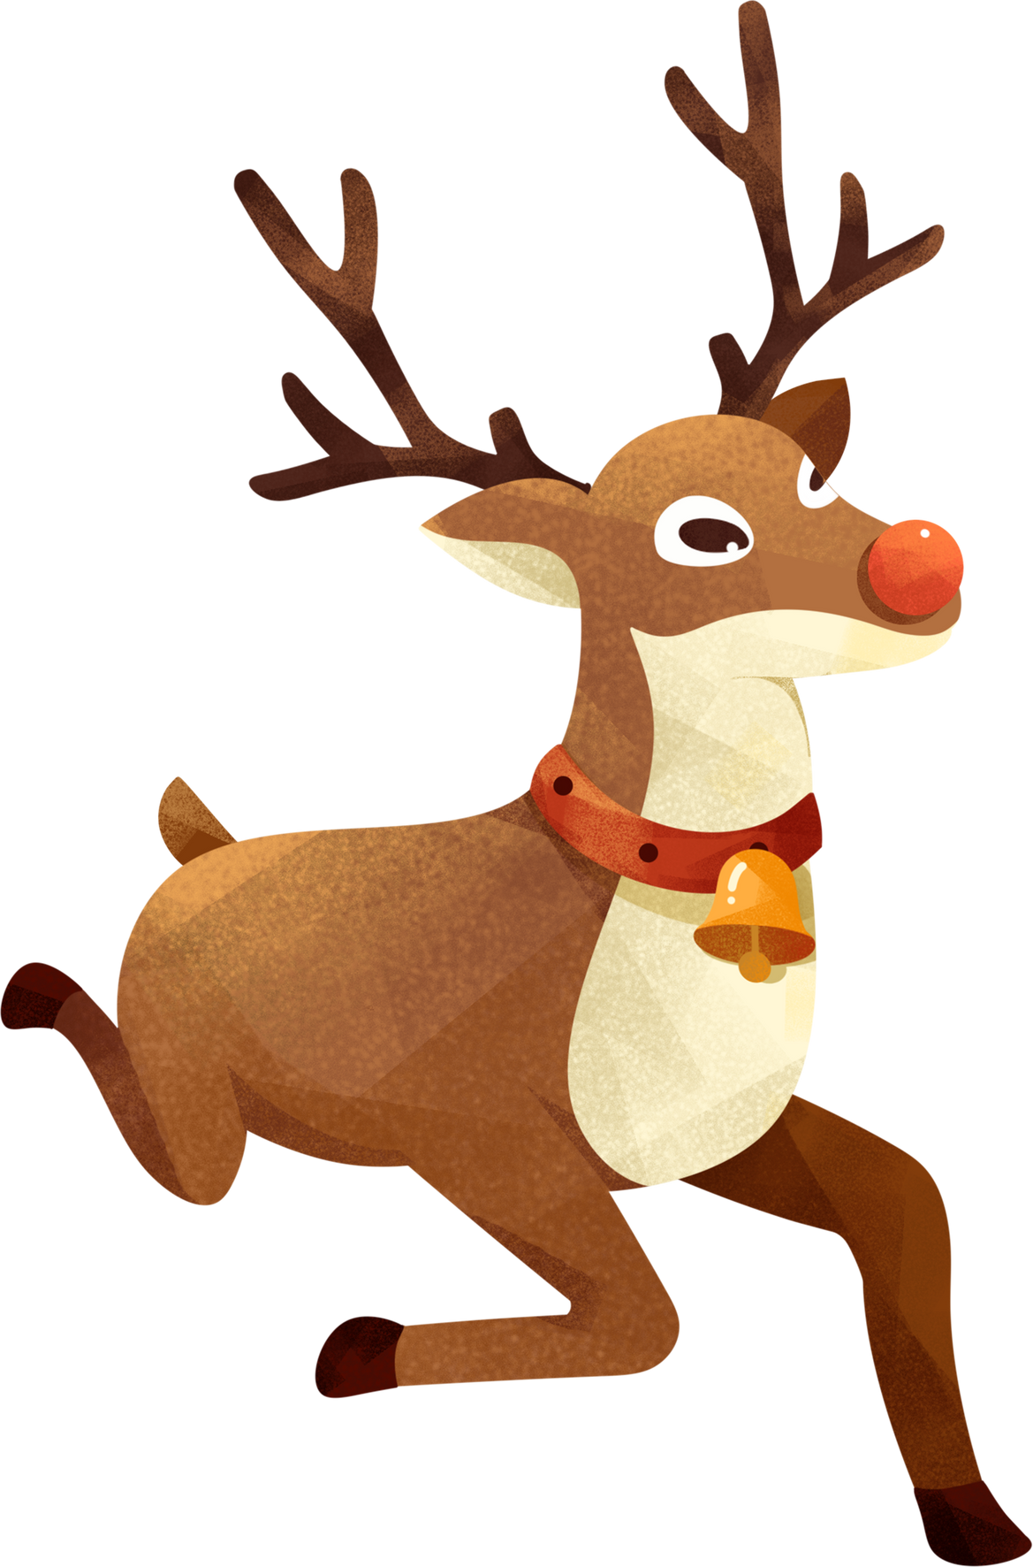

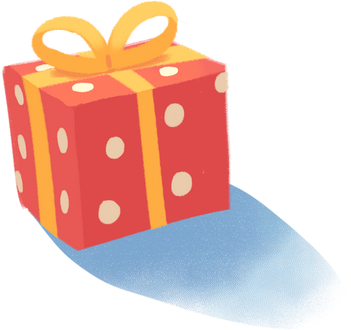


Christmas
The Spirit of Celebration, Joy, and Giving

Slide 2

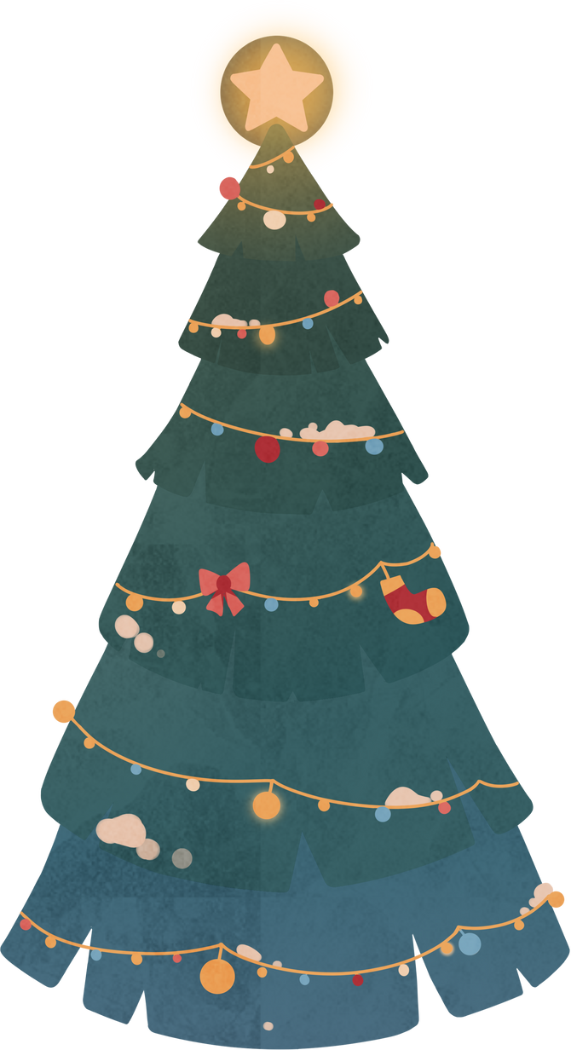



Introduction
Today, we’ll explore the history, traditions, and various ways people celebrate this holiday across the world. Christmas is a time for joy, togetherness, and reflection on the year.

Slide 3



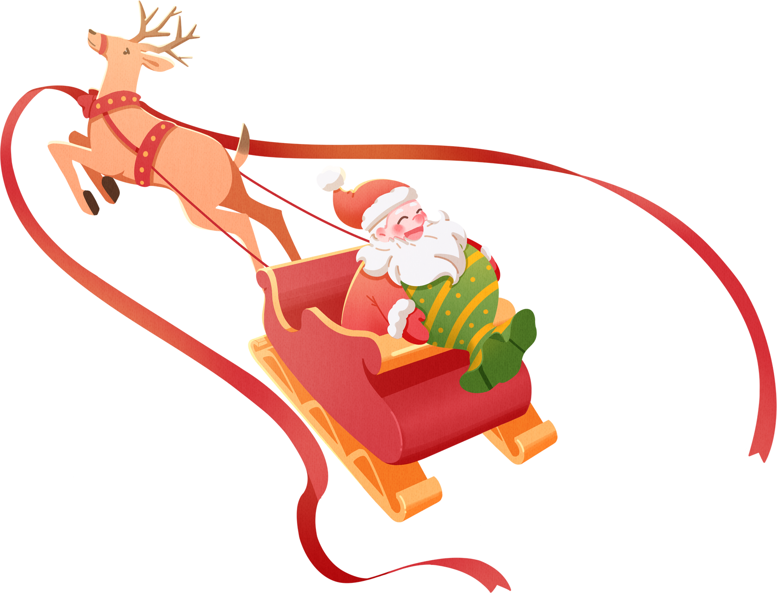

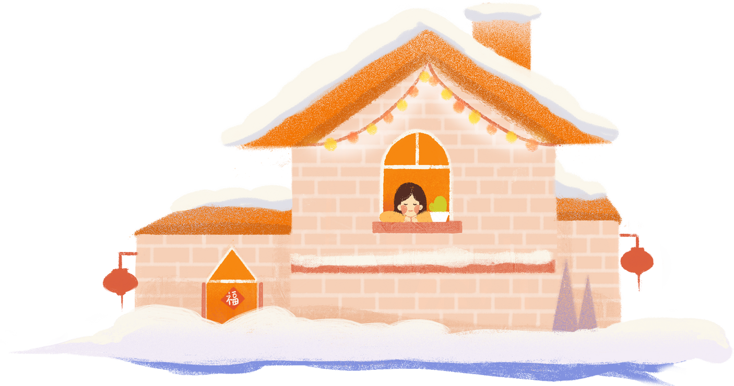


The Origin of Christmas
Christmas is celebrated on December 25th and commemorates the birth of Jesus Christ in Christianity. While its origins are religious, Christmas has become a widely recognized holiday with cultural and social significance.

Slide 4

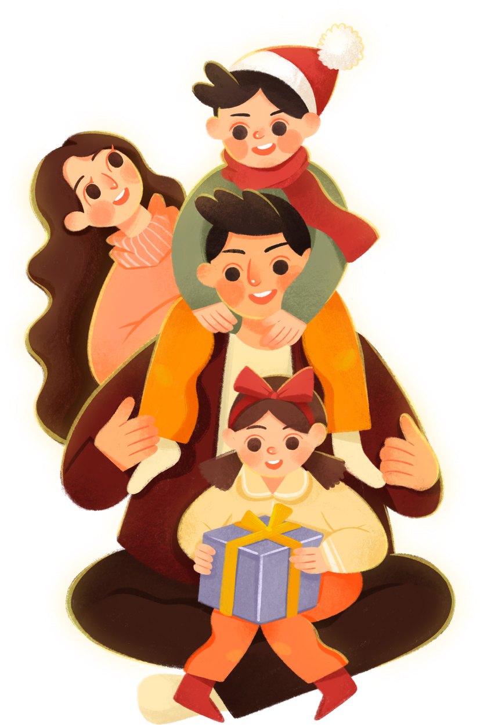
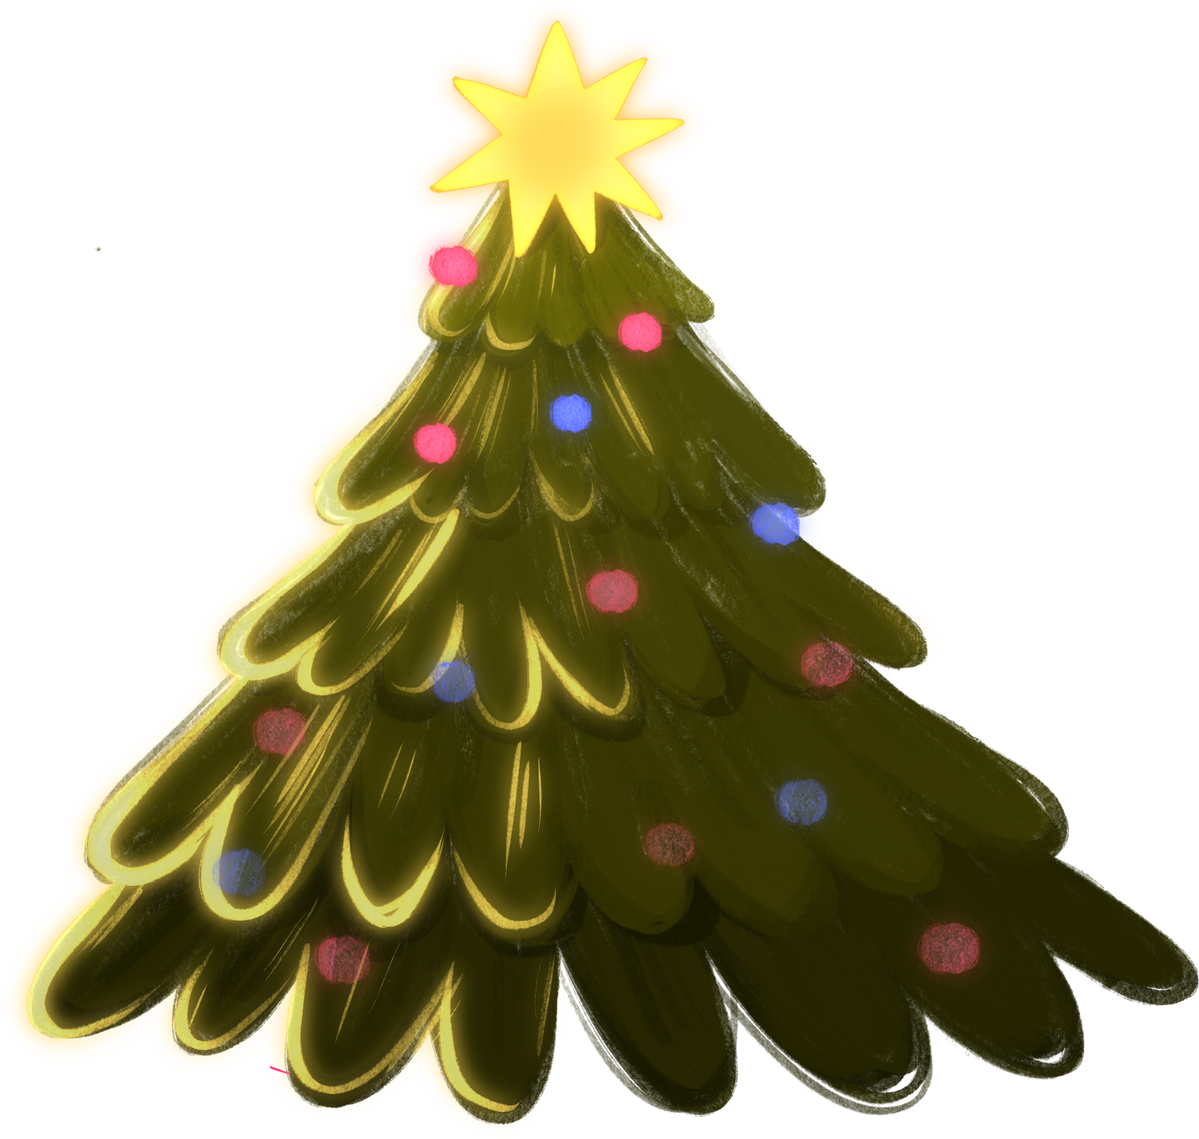

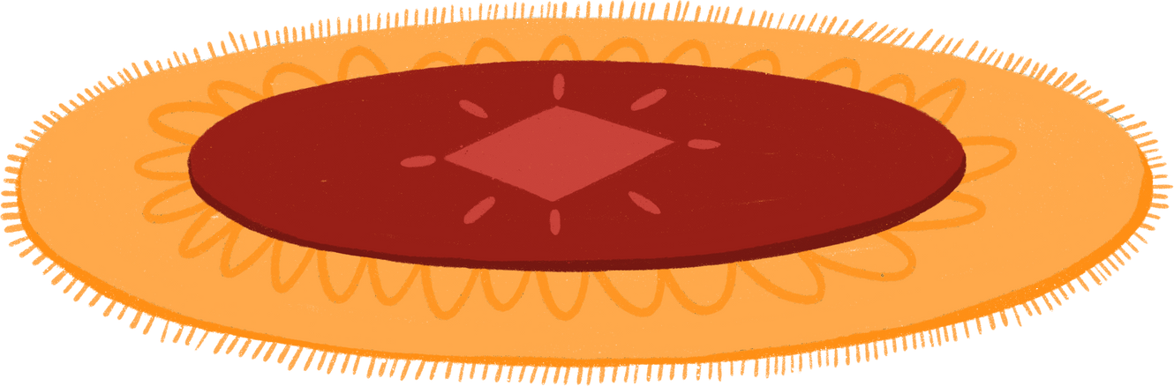
The Meaning of Christmas
Christmas is more than a holiday, it symbolizes love, generosity, and joy. It’s a time when families and friends come together to celebrate, exchange gifts, and spread kindness. The spirit of Christmas reminds us to cherish what we have and share with others.

Slide 5

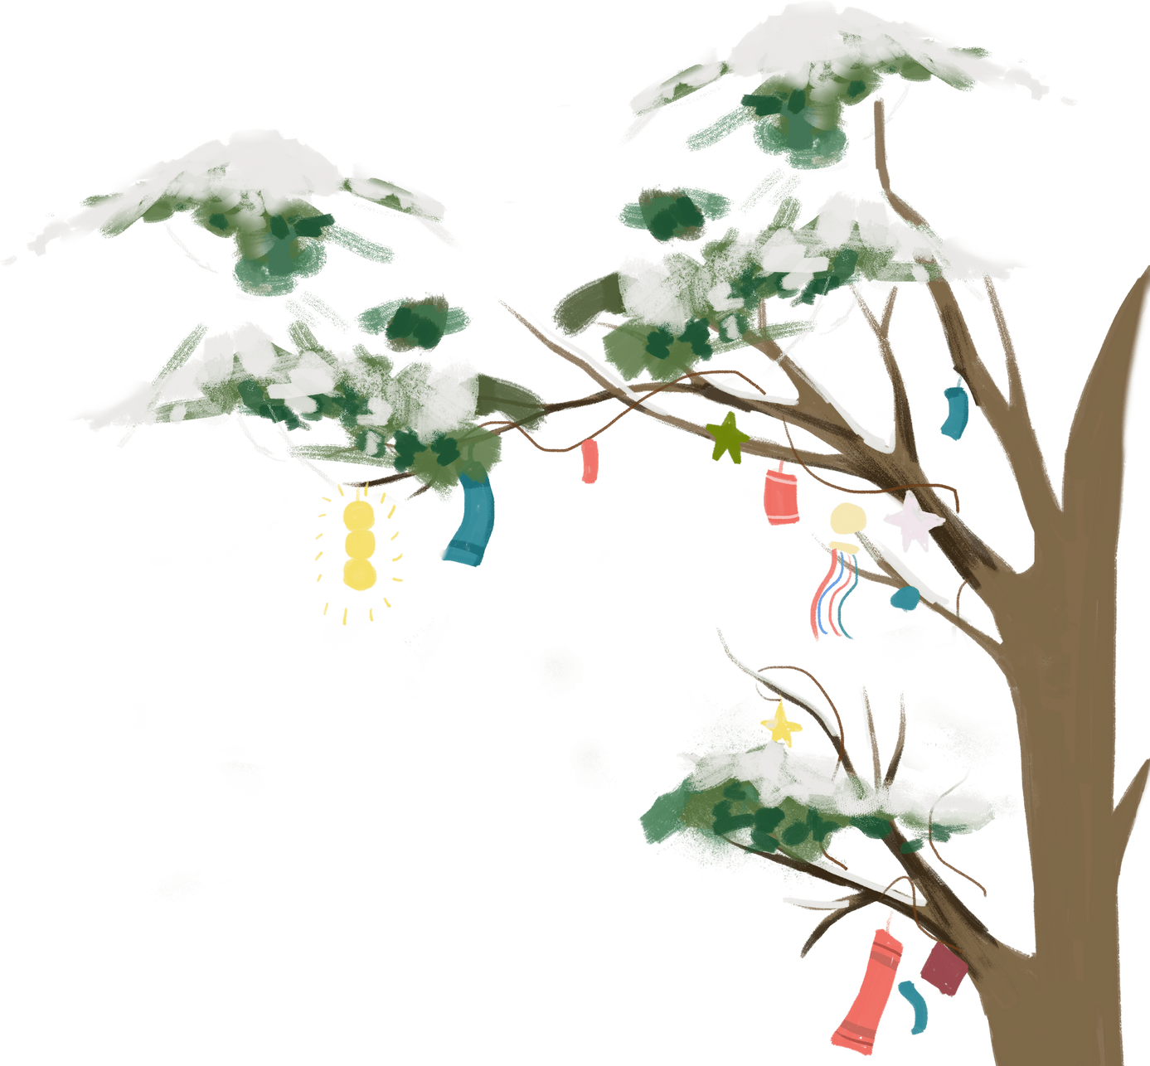

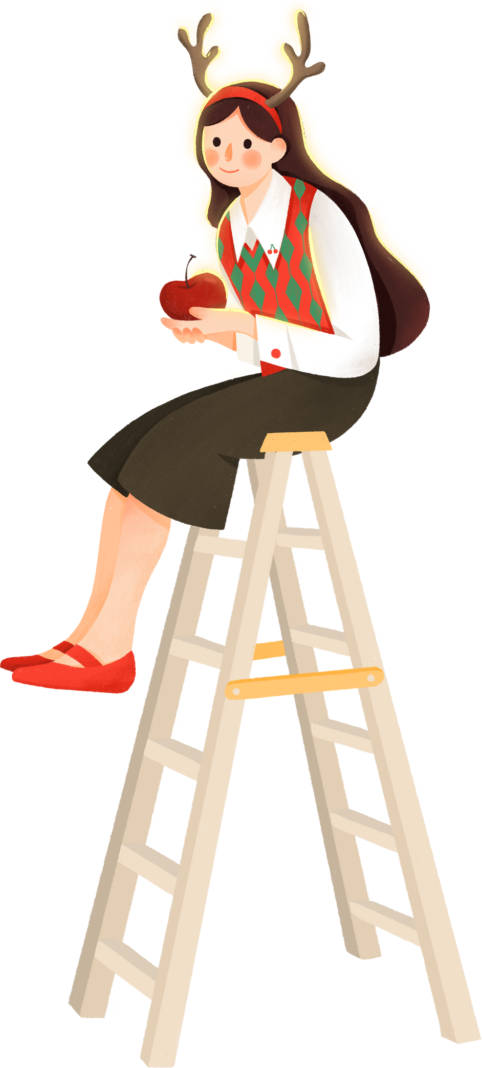

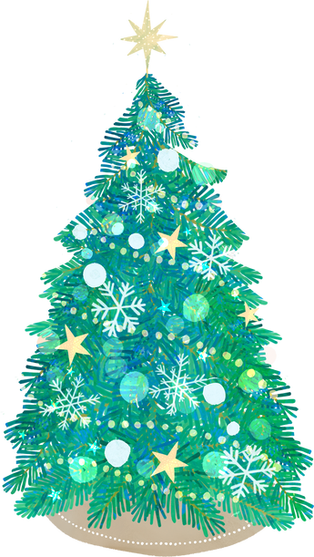

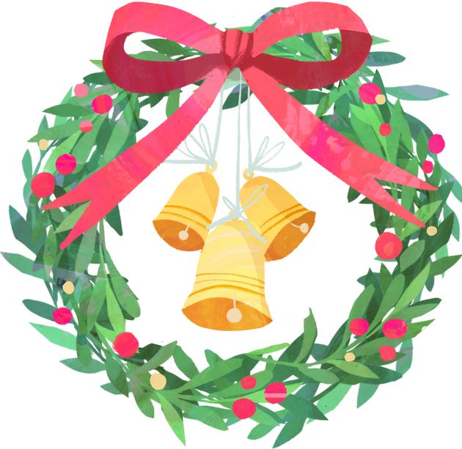

Christmas Symbols
Some popular Christmas symbols include:
Christmas Tree
Santa Claus
Star
Bells
Represents everlasting life and renewal.
Symbolizes generosity and joy for children.
Represents the Star of Bethlehem that guided the Wise Men.
Symbolize the proclamation of the Christmas spirit.

Slide 6
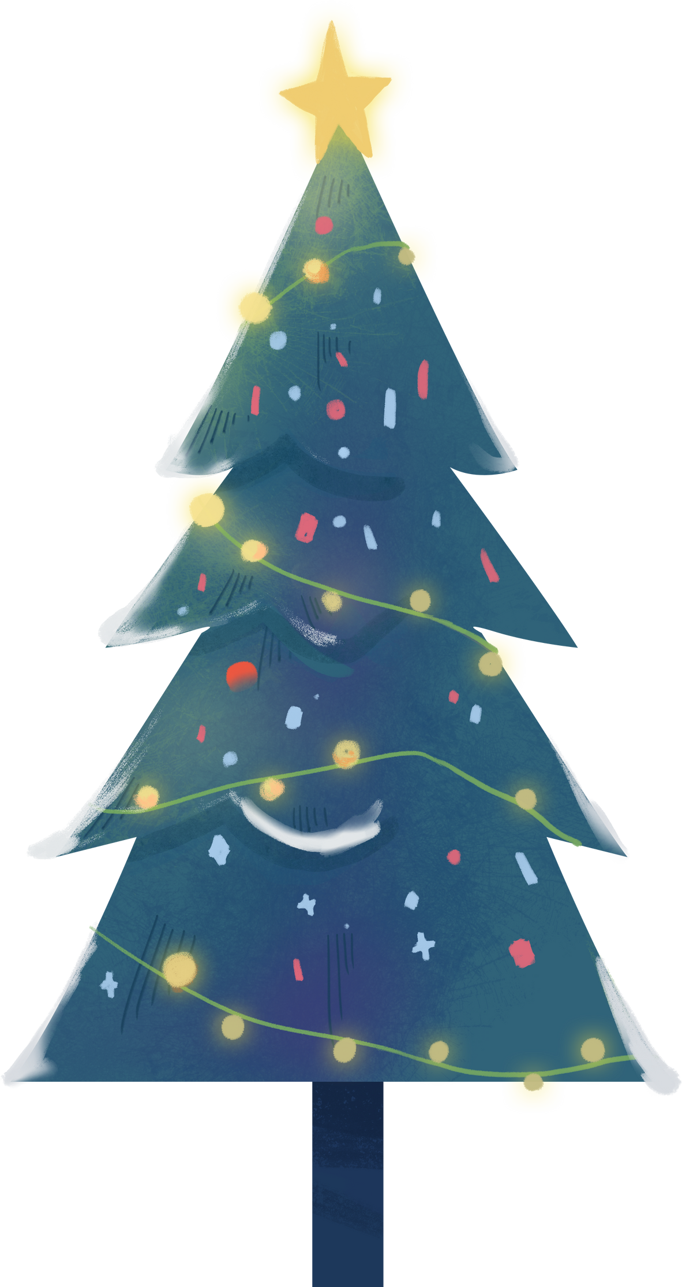

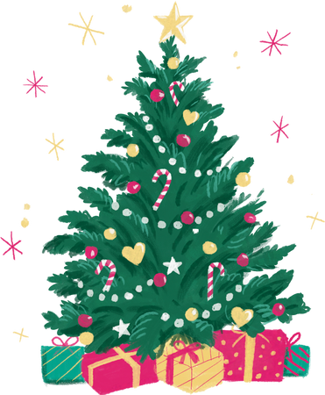

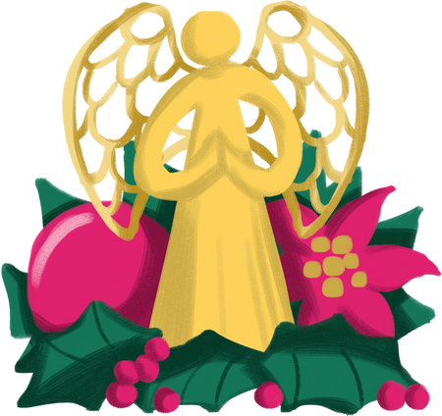
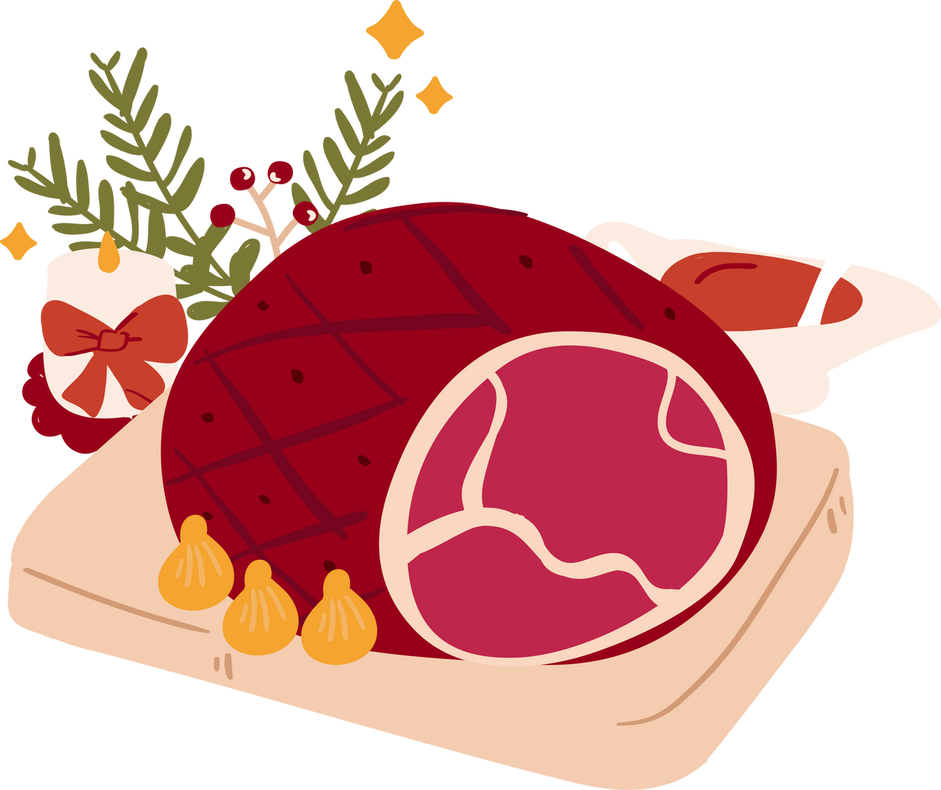
Christmas Traditions
Christmas traditions vary but often include:
Caroling and Singing Christmas Songs
Decorating the Christmas Tree
Exchanging Gifts
Enjoying Festive Meals

Slide 7

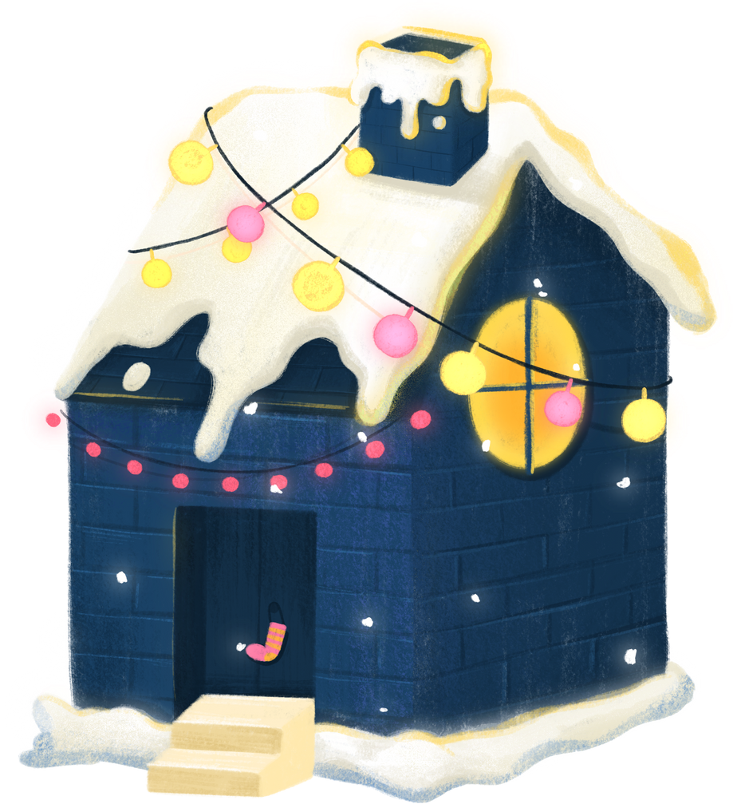
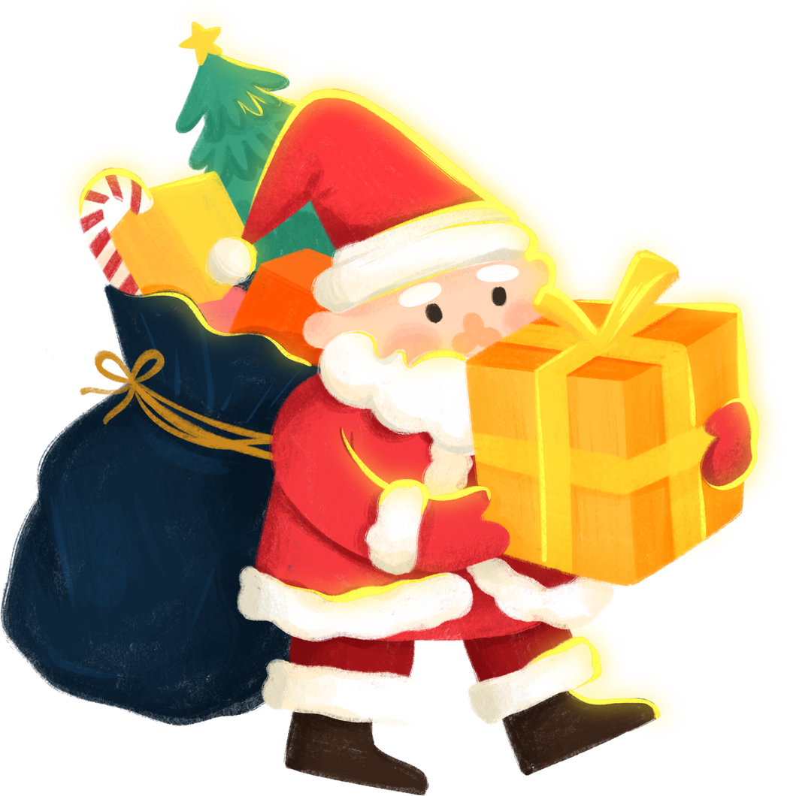
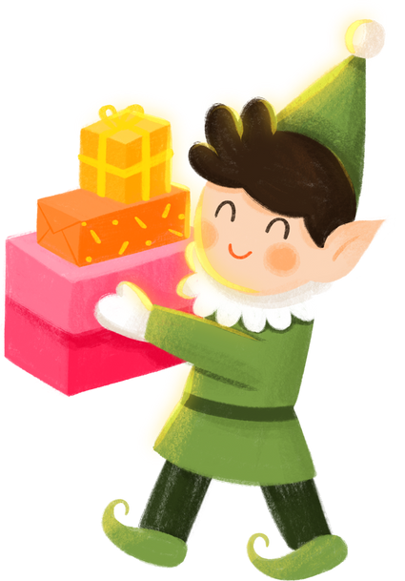
Giving and Charity at Christmas
Christmas is a time to spread kindness and give to others, especially those in need. Many people donate to charities, volunteer, and share with the less fortunate. The true spirit of Christmas is shown through generosity and compassion.

Slide 8

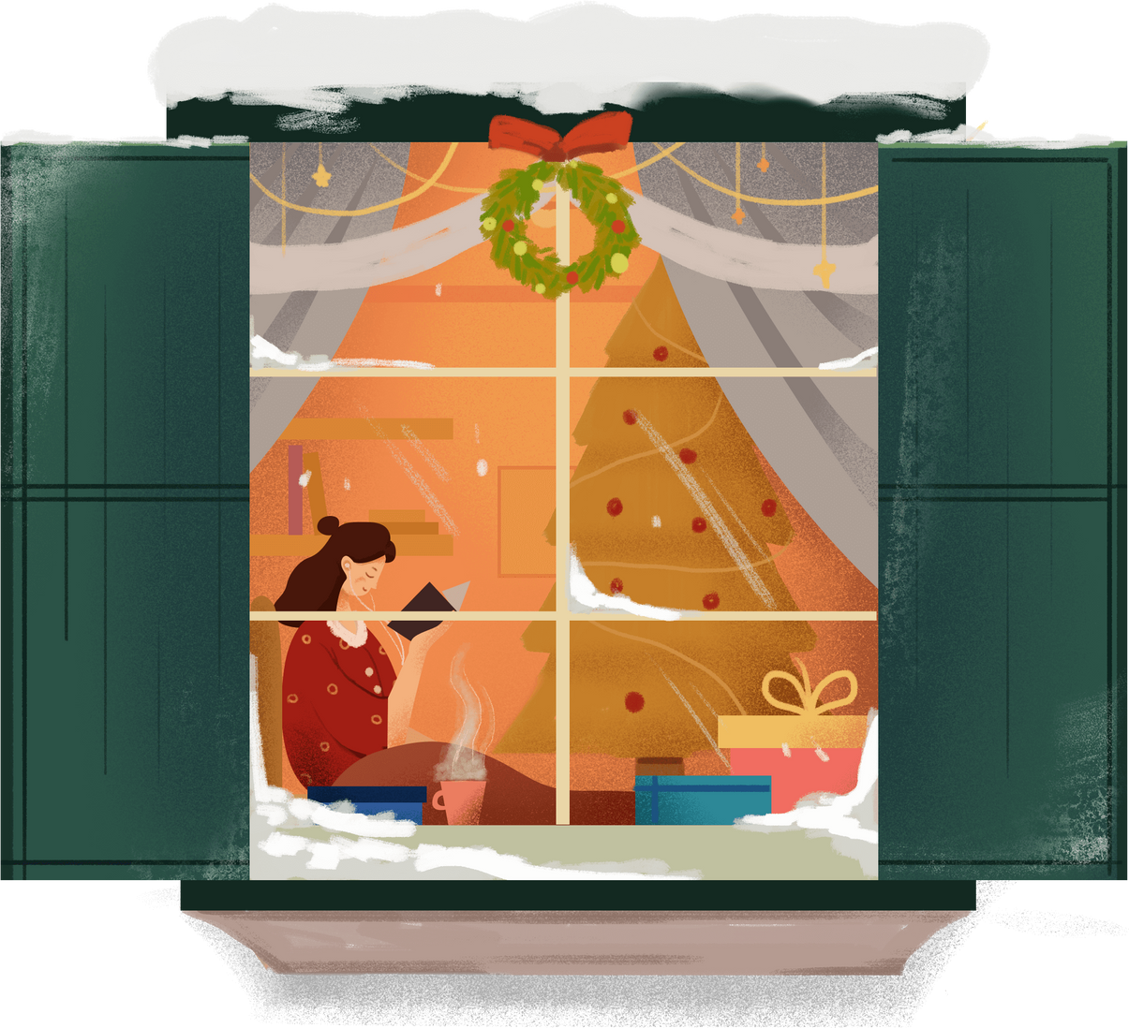
Conclusion
Whether through family gatherings, festive meals, or acts of kindness, Christmas is a season that brings warmth and joy.

Slide 9


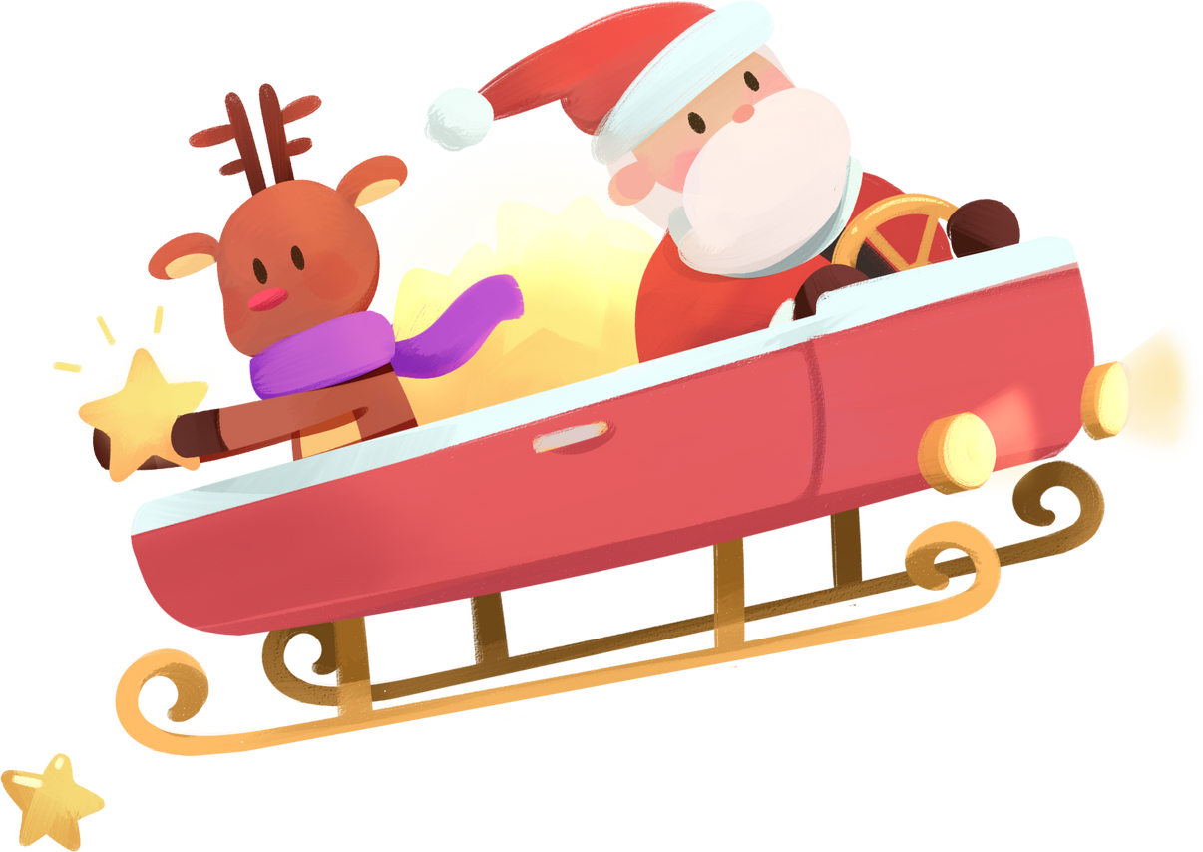
“Let’s carry the spirit of Christmas of love, generosity, and joy into every day of our lives.”

Slide 10

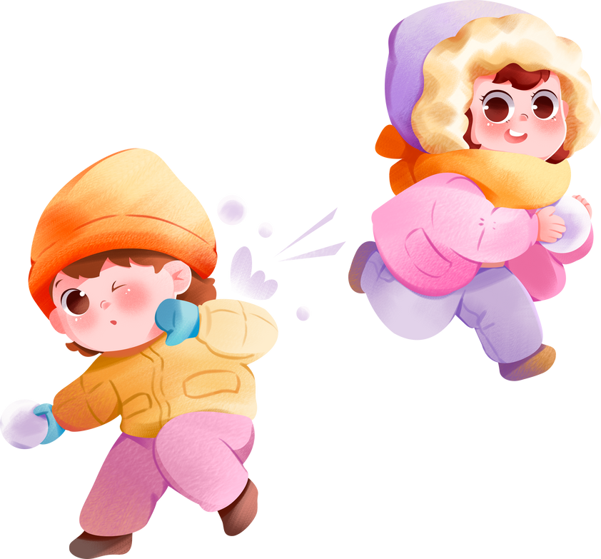

Merry Christmas!

